Slide 1
MINORITY ETHNIC DEVELOPMENT FUND
Guidance for applicants
January 2021

Slide 2
This presentation will be available on the TEO website: www.executiveoffice-ni.gov.uk/articles/racial-equality

Slide 3
What does the MEDF aim to do?
Equality of service provision - People from a minority ethnic background can access and benefit from all public services equally;
Elimination of prejudice, racism and hate crime;
Increased participation, representation and belonging - People from minority ethnic backgrounds participate in and are represented fully in all aspects of life and enjoy a sense of “belonging”; and
Cultural diversity is celebrated - The rights of people from minority ethnic backgrounds to maintain their culture and traditions in line with human rights norms and to pass them on to subsequent generations are recognised and supported.

Slide 4
Key features of the MEDF
Assist with delivery of the Racial Equality Strategy 2015-2025; and
Support for voluntary and community organisations working with minority ethnic people/groups.

Slide 5
Tiers of Funding
Overall there are three broad tiers of funding:
Tier 1 – £100 - £10,000
Tier 2 – £10,000.01 - £45,000
Tier 3 – £45,000.01 - £75,000
DEADLINE – 2.00PM ON 25th JANUARY 2021

Slide 6
Tiers of Funding - breakdown
Tier 1a – £100 - £5,000 – contributes to ONE Racial Equality Outcome (section B.2 of the application form)
Tier 1b – £5,000.01 - £10,000 - contributes to TWO Racial Equality Outcomes
Tier 2a – £10,000.01 - £30,000 - contributes to THREE Racial Equality Outcomes
Tier 2b – £30,000.01 - £45,000 - contributes to ALL FOUR Racial Equality Outcomes
Tier 3a – £45,000.01 - £60,000 - contributes to ALL FOUR Racial Equality Outcomes. Must also involve collaboration OR mentoring (section B.7 of the application form).
Tier 3b – £60,000.01 - £75,000 - contributes to ALL FOUR Racial Equality Outcomes. Must also involve collaboration AND mentoring (section B.7 of the application form).

Slide 7
Tiers of Funding - Summary
Remember, do not fill in more outcomes than detailed for the tier you are applying for.
This will not achieve additional marks.
Tier 1a – choose one outcome
Tier 1b – choose two outcomes
Tier 2a - choose three outcomes
Tier 2b – all four outcomes
Tier 3a - all four outcomes. Choose collaboration OR mentoring.
Tier 3b - all four outcomes. Collaboration AND mentoring.
For Tier 1a, 1b and 2a – decide which outcome/outcomes you think your application most contributes to (paragraph 2.1 of the guidance notes. DO NOT draft your own outcomes).

Slide 8
Selection Criteria
The MEDF Selection Panel will take account of the:
Extent to which proposal contributes to the MEDF aims/outcomes;
Extent to which the proposal meets a specific need(s) and the extent to which it is targeted on people, groups or areas of greatest social need;
Extent to which the proposal aims, objectives and outputs are SMART i.e. Specific, Measurable, Achievable, Relevant and Time-bound and assessment methods are demonstrated;
Availability of match funding, the sustainability of the proposal and value for money; and
Extent of promotion of volunteering and use of volunteers.

Slide 9
Selection Criteria
They will also wish to be aware of:
Receipt of funding from other sources such as Government Departments, European Programmes or the International Fund for Ireland or other charitable sources;
How the funding sought from TEO will complement funding from other sources; and
Geographical spread of funding and the extent to which it covers Northern Ireland.
The Panel will seek to avoid funding projects which duplicate work already being undertaken by others. Where two or more applications substantially overlap any award will go to the application which scores higher marks.

Slide 10
Application process
Applications for all tiers of funding must be received by 2.00pm on 25th January 2021;
Application form is available electronically;
We will issue an acknowledgement and a reference number; and
Racial Equality Unit happy to answer queries.

Slide 11
Application form
The application form is only available in PDF format – a word version of the form is NOT available (we don’t have one).
Do not try to convert the PDF into a word document – this will change the formatting.
There were issues in previous rounds of funding with extensive reformatting of the word document by some applicants, despite the instruction of the front page of the application not to alter the form – or with applicants submitting more than 21 pages. This resulted in them being disqualified.
Our I.T. colleagues have advised us this is the best way to proceed.
Remember to use Adobe Reader to fill in the form. Using other software has the potential to corrupt the form.
If you don’t have Adobe Reader it can be downloaded for free at: https://acrobat.adobe.com/uk/en/acrobat/pdf-reader.html

Slide 12
Application form – your organisation
A.2 Please provide a short profile of your organisation as it relates to this application
You should include the aims and objectives of the organisation and indicate how these align with
the aims of the funding scheme at paragraph 2.1 of the guidance notes.
Give some brief background about your organisation and set the funding application in context.
Remember this is just to provide some background information for the Selection Panel – there are no marks for this section.

Slide 13
Application form – your proposal
B.1 Tell us about your proposal
Describe what you will do and how you will do it and the outcome(s) you expect to achieve. If you will work in partnership with any other groups please say which organisations.
Give an overview of your proposal - remember what the Selection Panel are interested in and try to demonstrate what they are looking for.
Remember to get permission from any groups you are working, or planning to work, in partnership with.

Slide 14
Application form – your proposal
B.2 In these four following boxes, outline the outcome or outcomes for the funding scheme (paragraph 2.1 of the guidance notes) your proposal contributes to and how it contributes. Use a box for each of the outcomes.
(Please see paragraph 3.1 of the guidance notes for how many outcomes you should fill in for the tier you are applying to).
Look carefully at the 4 outcomes of the MEDF and take the time to fully explain how your proposal helps contribute to the outcome or outcomes.
Remember, check how many outcomes you need to fill in for the Tier you are applying to – additional marks will not be given if you fill in more.

Slide 15
Application form – your proposal
B.3 Outline evidence that your proposal addresses a specific need or needs and is targeted on people, groups or areas of greatest social need
Please see paragraph 5.1 in the guidance notes for the selection criteria
Who will benefit from your work? What evidence is there for the specific need or needs? Use evidence for your assertions – e.g. census figures/research statistics.
If there are no official statistics for your assertions, refer to what you have found during the course of your work.
Remember to ensure any statistics you use are relevant to NI - eg if you are referring to ‘UK’ statistics, make sure NI is included in these and not just GB. If you still use statistics that don’t refer to NI – explain why you think they are applicable.

Slide 16
Application – your proposal
B.4 Agreed activity: what will you actually do
Under section B.2. you stated the specific outcomes that your proposal would contribute to. We would now like you to summarise what you will actually do, how much you will do and how you will know whether you are doing it well or not.
Racial Equality Outcome | Activity Description | Output measure |  | Target date | Outcome measure
 |  | How much did we do? | How well did we do it? |  | Is anyone better of as a result?
Do not include activities you are doing or have applied to do for other funders.
You must spell out exactly what activities, outputs and outcomes you are planning. You must also show how you plan to measure success – these should be SMART!
The detail in B4 will form the basis of the letter of offer should your application be successful and will be used to inform monitoring and evaluation.
Be clear and concise.

Slide 17
Application – your proposal
B.4 Agreed activity: what will you actually do (continued)
Activities you will be doing or have applied to do for other funders
We want to clearly see what money from the Minority Ethnic Development Fund is supporting.
This makes it easier when we have to report to Ministers and others about the Fund.
We also want to make sure that each application is being marked fairly – some applicants were including activities they would be doing/had applied to do for other funders – some were not.
There is also an issue if organisations did not secure funding to carry out activities included in their Letter of Offer – if all the targets are not being achieved this could lead to a reduction in the funding award.
If your application to the MEDF will support work being done for other funders e.g. management of a project – be clear about that and explain how that works.

Slide 18
Application – your proposal
B.5 a) Outline how your proposal will be sustained, if necessary, beyond the period to be funded. b) Also outline the likely sustainable benefits which will be realised as a result of the proposals. Detail any match funding.
Detail the legacy of the work proposed in your application.
Make sure you answer both parts of the question! It’s easy to lose out on marks if you don’t.

Slide 19
Application – your proposal
B.6 Please detail the extent to which your organisation uses volunteers or promotes volunteering
How many volunteers are involved? How often are they involved? In what areas do they help?
We see volunteering as important as it builds capacity in the sector.
If there are difficulties with volunteering state what these are.

Slide 20
Application – your proposal
B.7 Working with others
Tier 3 awards are specifically intended to support organisations in working with others in the sector (see page 8 in the guidance notes for detail). This could take the form of collaboration and/or mentoring. Please provide details of what you intend to do below (as well as including these in the table of agreed activity at B.4).
This section is for Tier 3 applications only.
How will you work with other organisations? How will you provide assistance to new and less experienced organisations?
Ensure that if you are collaborating with/mentoring other group(s) that you have their agreement – it shouldn’t come as a surprise to them!

Slide 21
Application – layout
Consider how you lay out your answers.
Selection Panel members consistently tell us of applications that are very difficult to read because of the sheer amount of information provided – sometimes this can make it difficult to work out what groups are proposing to do.
More text doesn’t necessarily mean more marks.
Your responses should be well structured and clearly linked to the question. We recommend you use bullet points and headings where possible.
On the next 2 slides we have set out what a good example and a bad example might look like, using placeholder/filler text to demonstrate.

Slide 22
A lot of text included with few paragraphs or spaces – making it difficult to read

Slide 23
Clearly sets out what activities the organisation will be doing to contribute to this outcome. Easy to read

Slide 24
Application form – common mistakes
Incomplete or lacking information
Inaccurate, unrealistic or unclear budget figures
Not clearly explaining the need
Not providing evidence for the need
Not answering all parts of a question
Poorly described outcomes
Tier 3 applications – not being clear on the mentoring and/or collaboration aspects of the proposal
Missing deadlines or having no time to correct mistakes – the vast majority of applications are received on the day the Fund closes

Slide 25
Application – your proposal
Section C Financial Information
Remember to detail funding achieved or applied for from other sources.
If you are seeking salary costs, detail all the hours of the post (whether or not TEO is funding 100% of these costs) and how many hours you are applying to TEO for funding.
Make sure you also include the names of the posts you are seeking funding for at section C.6.
Ensure that the total costs applied for do not breach the limit of the tier you are applying to – your application will be rejected.
Most importantly, please ensure your figures add up!

Slide 26
Application – signing
Section D Declaration
At least one of those signing must be an office bearer.
On behalf of the organisation, we confirm that we have read all of the pages of this application form and the information on this form is correct and that, if this application is successful, we will comply with TEO requirements.
We also confirm that our organisation is properly constituted, that there are robust and appropriate
governance procedures in place and that our organisation has not previously had funding refused or
breached a letter of offer from any funder.
Signed: | Signed:
Name: | Name:
We need an office bearer so we know that the application has been agreed by the organisation.

Slide 27
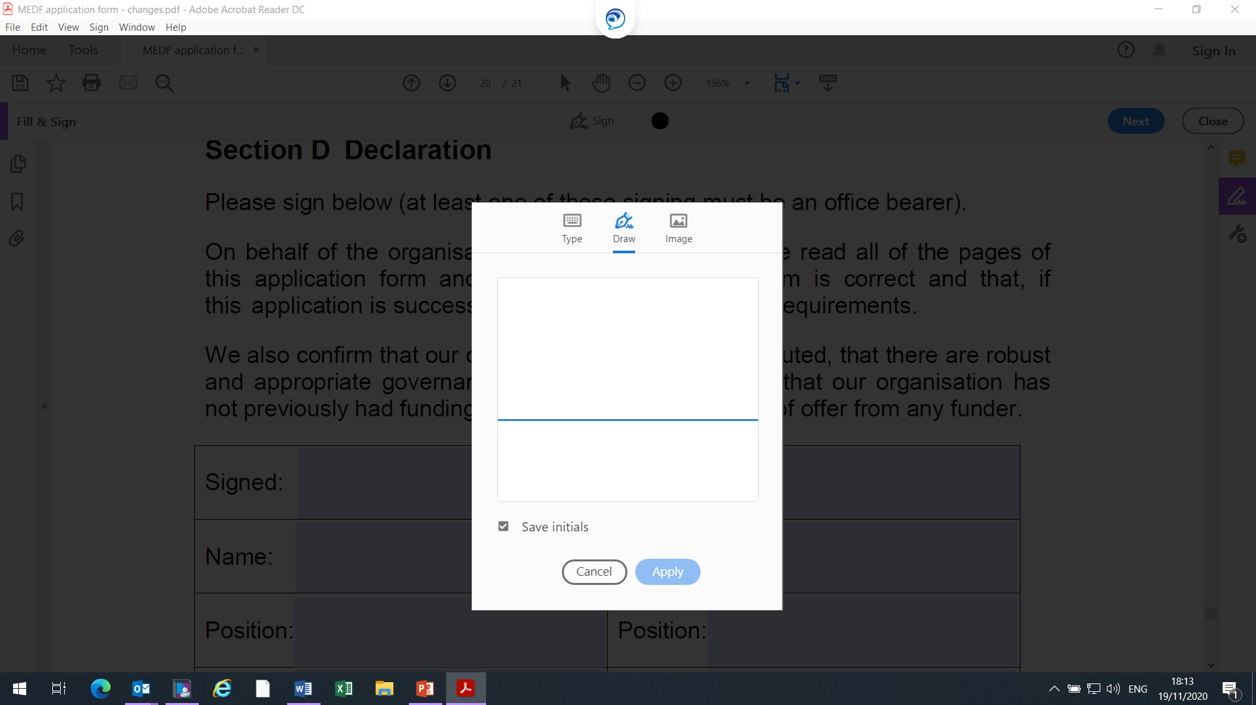
Application – signing
Make sure you click on ‘sign’ when you have finished editing the document. Once the document is ‘signed’ it is treated like any hard copy document and no further amendments can be made – it finalises the document.

Slide 28
Before submitting your application
Double check you have not broken one of the rules that will mean the disqualification of your application:-
Questions, formatting, and box sizes must not be changed or resized. Altered forms will be rejected. Only use the pdf application form provided – do not amend the form (or try to convert it into a word document – this will corrupt the formatting);
Check the application does not exceed 21 pages. Applications that exceed 21 pages will be rejected;
Check the limit for each tier has not been exceeded (Tier 1a - £5,000, Tier 1b - £10,000, Tier 2a - £30,000, Tier 2b - £45,000, Tier 3a - £60,000, Tier 3b - £75,000). Any application that does not “fit” the tier applied for (eg an application for £50,000 under Tier 2b) will not be considered. Check and re-check your sums!
Applications to Tier 1 should not be used as a ‘top-up’ in addition to Tier 2 funding – any such applications will be rejected. Applications for core funding of more than £45,000 should be made to Tier 3.
Closing time for receipt of all applications is 2.00pm on 25th January 2021. Applications which arrive after the deadline will not be considered.
It is recommended you submit your application well before the deadline in case there are any issues as this will give you an opportunity to rectify these.

Slide 29
Funding decisions
We will let you know the outcome of your application as soon as possible – our aim is to let you know by the end of February with commitments subject to confirmation of budgets.
If you are unsuccessful you can ask for feedback on your application.
If you believe the Selection Panel did not follow the procedures for assessing your application, you have the right to appeal against the decision.
However, applicants must avail of feedback on their application before making an appeal. After this point the Selection Panel’s decision is final.
Any appeal of the Selection Panel’s decision will be limited to a review of how the Selection Panel has applied the criteria and no new information will be accepted at this stage.
Further detail on the appeals process will be provided with your feedback letter.

Slide 30
Where to get help
Racial Equality Unit can advise on the process ONLY
Philip Devlin 028 90528560
Aideen Donnelly 028 90523157

Slide 31
Summary
Read the MEDF Guidance Notes thoroughly;
Ensure all eligibility criteria are met (Section 4, Guidance Notes);
Ensure that your application fits with the correct category/tier of funding (Section 3, Guidance Notes);
Ensure language used is non-technical;
Check your sums;
Consider the selection criteria (Section 5, Guidance Notes);
Ensure you are not breaking any rules on the front page/back page of the application form;
Remember to submit an application to each tier you wish to be considered in;
Ensure application is signed;
Check and double check you are sending the form to the correct email address – race.equality@executiveoffice-ni.gov.uk;
Remember the deadline – 2pm on 25th January 2021!
Remember that computers can break down, there can be broadband/email issues and as we’re all now familiar with, the unthinkable can happen. Leave enough time to submit your application!

